Slide 1
SeeFood
Jeyasri Subramanian, Ronak Mehta, Pranav Lodha

Slide 2
Purpose
People like to taste different cuisine and choose the most appealing food. They often are concerned about diet restrictions such as gluten-free, vegan, ketosis, peanut-allergy, and calorie count. We would like to provide an easy solution to making health and good looking foods that fit your daily calorie consumption limit.

Slide 3
Problem Statements
The project focuses on three major problem statements:
Food Classification.
Recipe Generation.
Calorie Estimation.
From the image of food captured, we determine the classification of food (such as donut, samosa, red curry), identify the calorie count and describe the cooking procedure of the food. With this information, an informed decision can be made on making the item or not.

Slide 4
Datasets
Food Classification: iFood - 2019 at FGVC. This dataset has 251 fine-grained (prepared) food categories with 118475 training images, 11994 validation images and 28377 test images.
Recipe Generation: Recipe1M. This dataset has training images of size 94GB, validation images of size 21GB, and test images of size 20GB.
Calorie Estimation: Recipe with Nutritional Info. This contains nutritional information scraped from Recipe websites which includes the ingredients present in the dish, nutrition per ingredient, values per 100g, title, units, URL, and weights per ingredients.

Slide 5
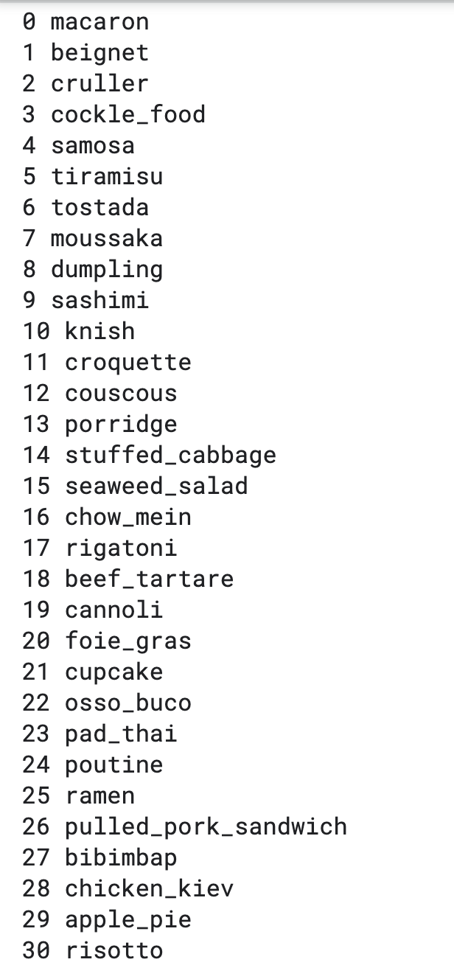
Food Classification
Food classification is a challenging problem due to the large number of food categories, high visual similarity between different food categories.
It’s multi-class classification problem to predict the 251 fine-grained food-category label given a food image.

Slide 6
Various Alternatives Explored
Transfer Learning involving VGG16 model trained with ImageNet weights and changing the output layer with the custom CNN architecture with adam optimizer. The model performed poorly after 24 epochs.
Since VGG16 needs an SGD optimizer. VGG16 pre-trained model was trained with SGD optimizer. The results were similar to that of the model trained with Adam.
Train all the layers of VGG16 with appropriate layers on top. The model gave better results but didn’t provide substantial change in the accuracy after 60 epochs.
Finetune Inceptionv3 pretrained model with L2 kernel regularizer with a penalty of 0.05 in FC layer, SGD optimizer with learning rate of 0.0001 and 0.9 momentum.

Slide 7
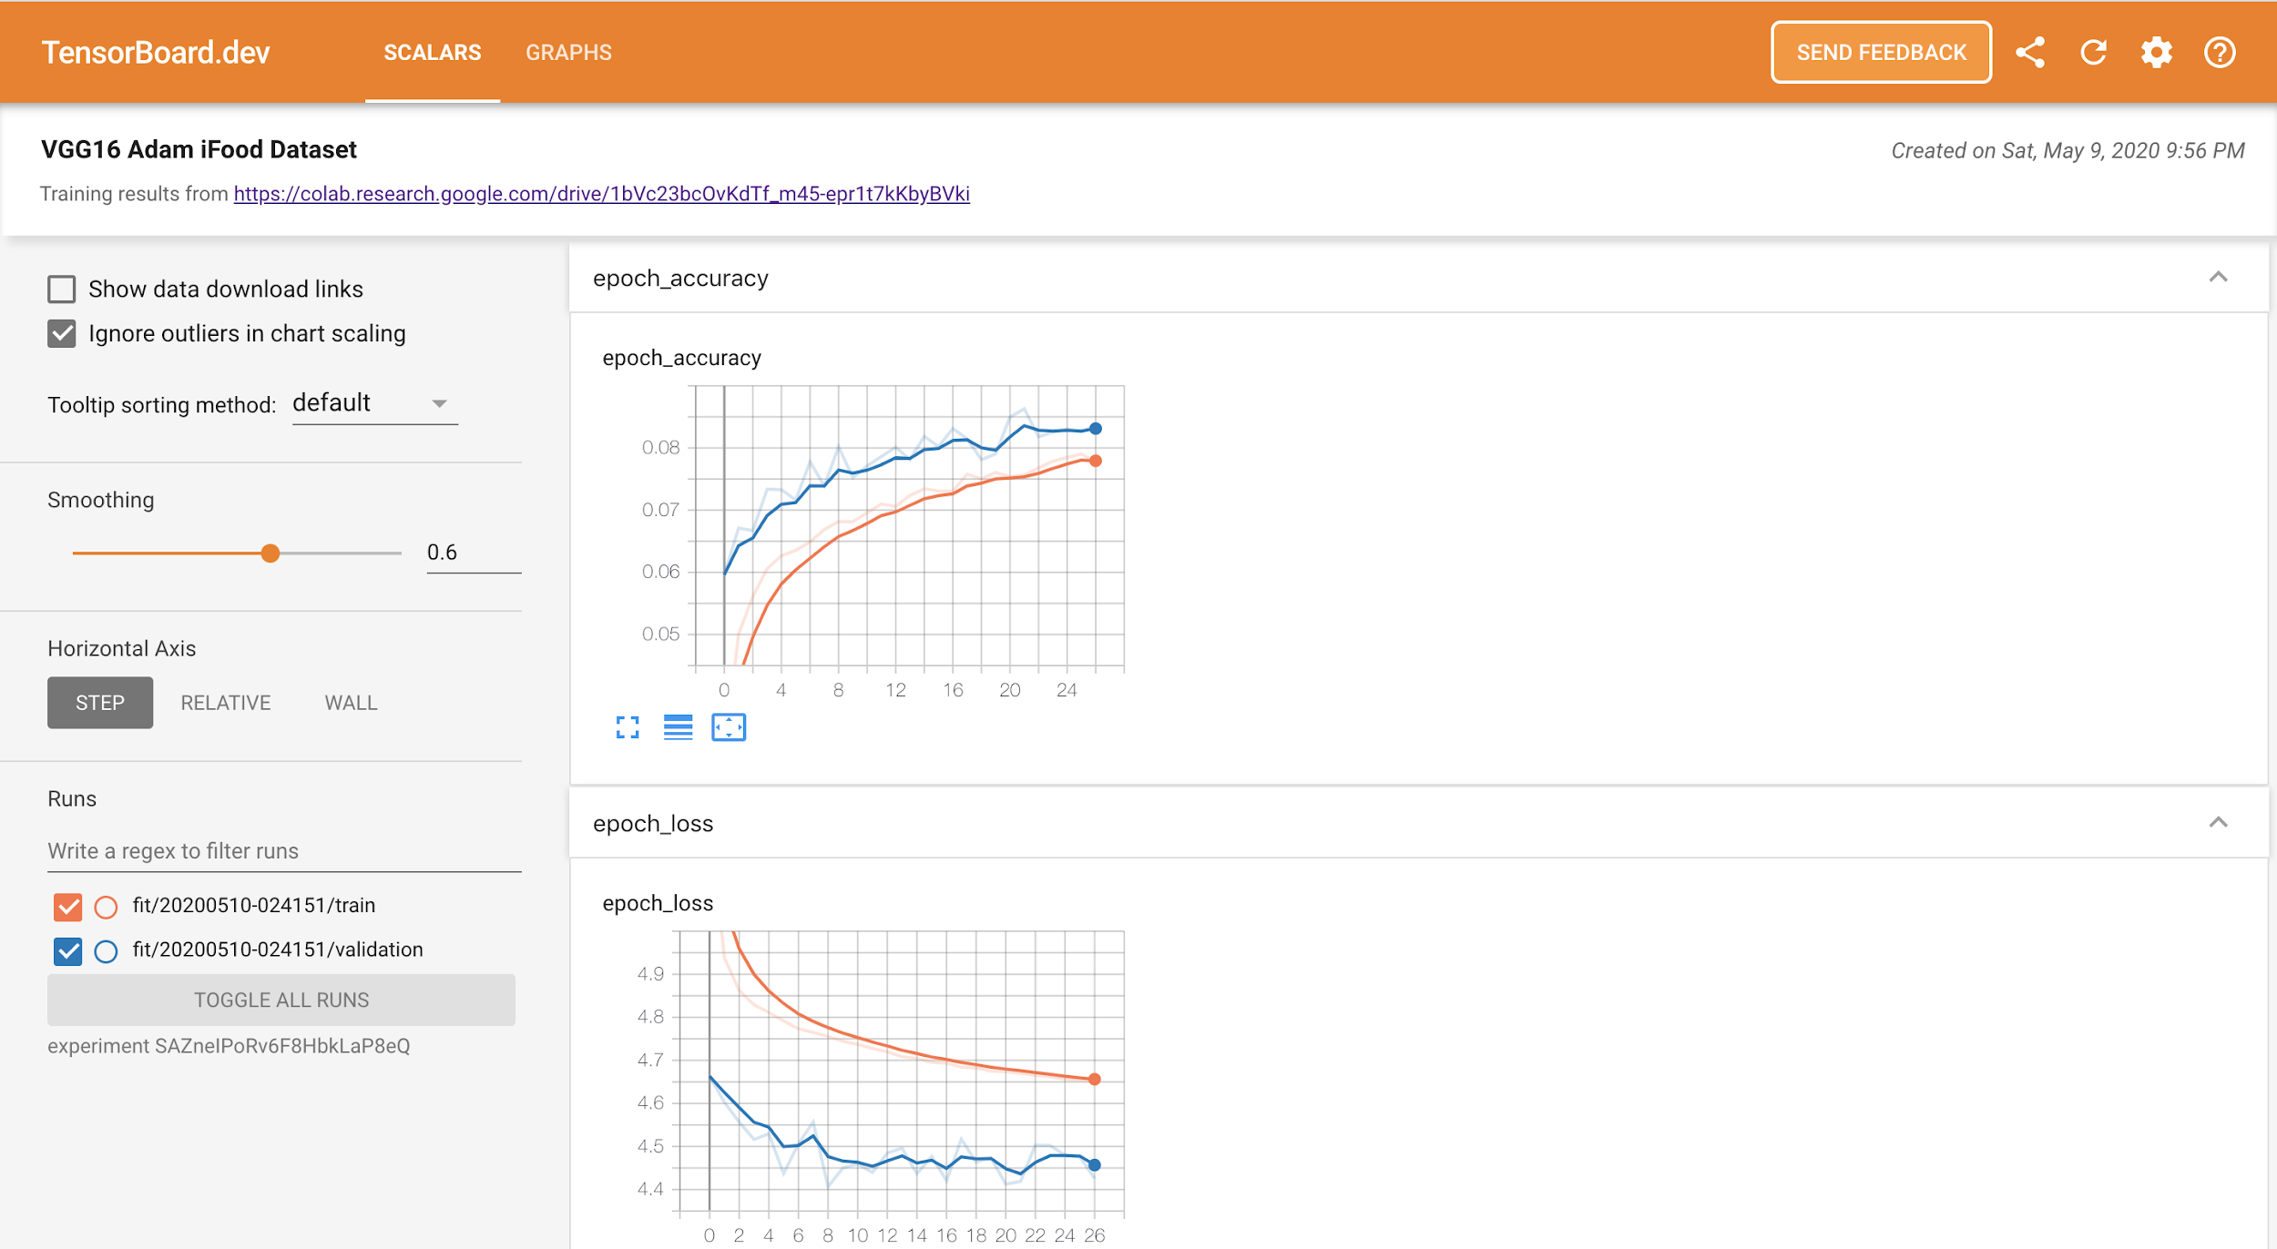
Notes:
https://tensorboard.dev/experiment/SAZneIPoRv6F8HbkLaP8eQ/#scalars

Slide 8
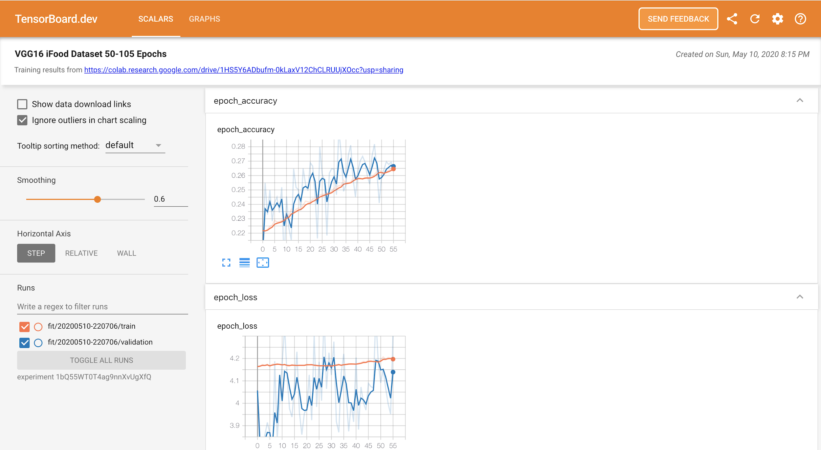
Notes:
https://tensorboard.dev/experiment/1bQ55WT0T4ag9nnXvUgXfQ/#scalars

Slide 9
Recipe Generation
Recipe Generation problem is resolved by three major sub-networks -
Food understanding (Extracting ingredients)
Multi-label classification (Detecting the food title)
conditional text generation (NLP). (Preparing recipe)
The pipeline extracts the image representation with resnet-50 encoder and obtain the ingredients.
Recipes are generated with identified ingredients into human readable format.

Slide 10
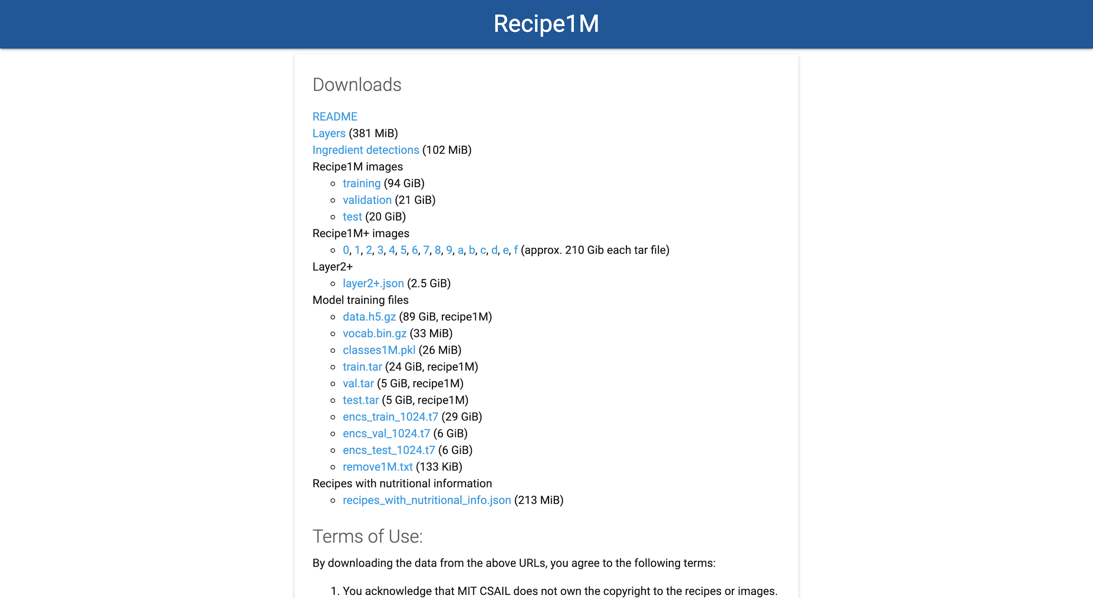

Slide 11
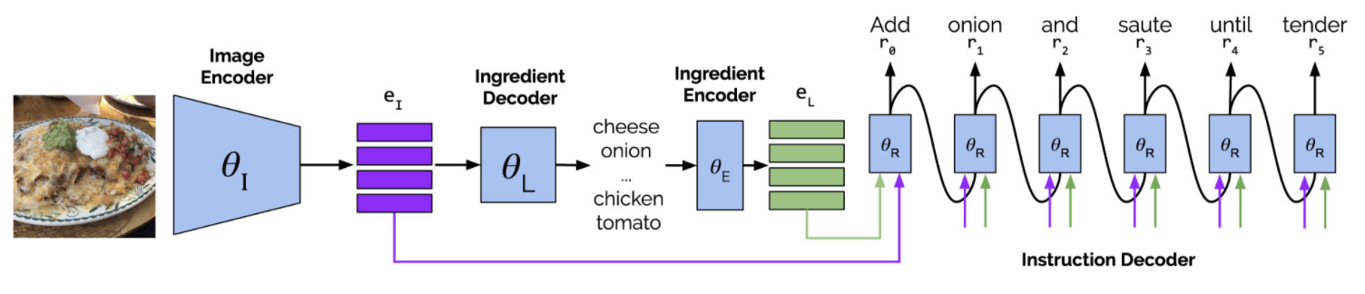
Architecture Diagram

Slide 12
Receipe Generation modules - Training stages
Build Vocabulary
Ingredient Prediction from image
Recipe generation from ingredients and images

Slide 13
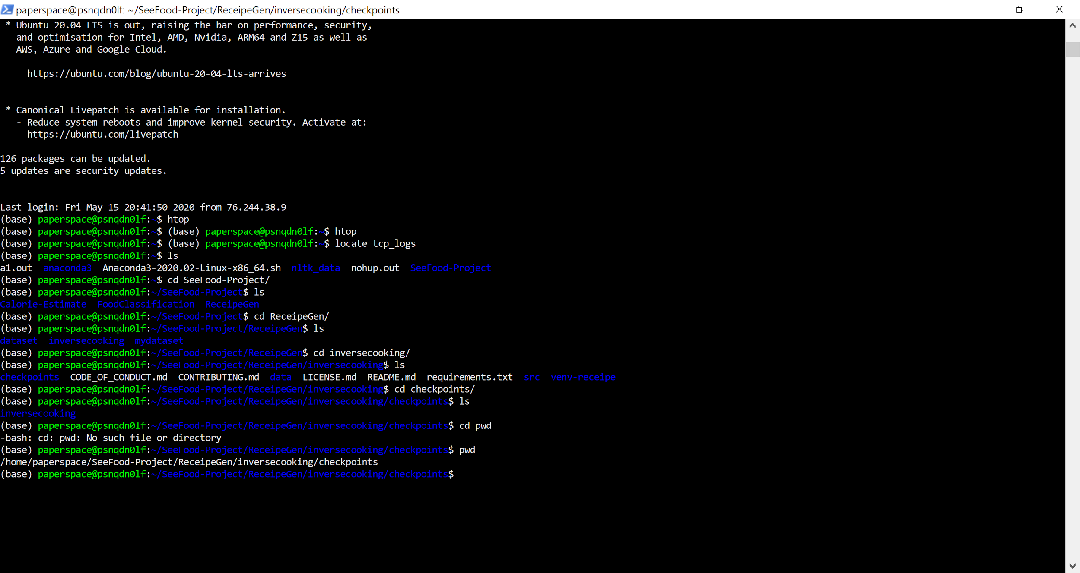
Cloud machine in Paperspace

Slide 14
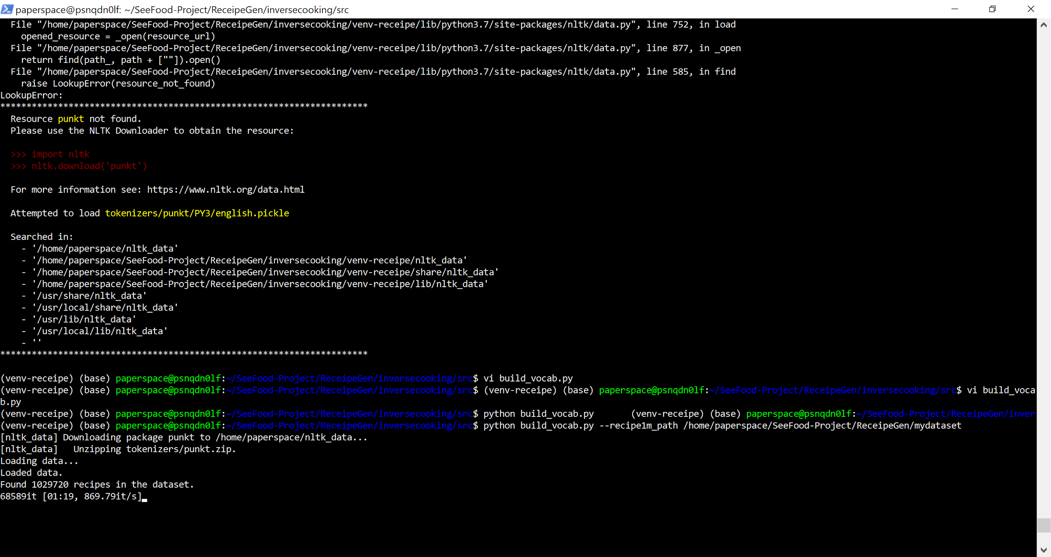
Stage 1

Slide 15
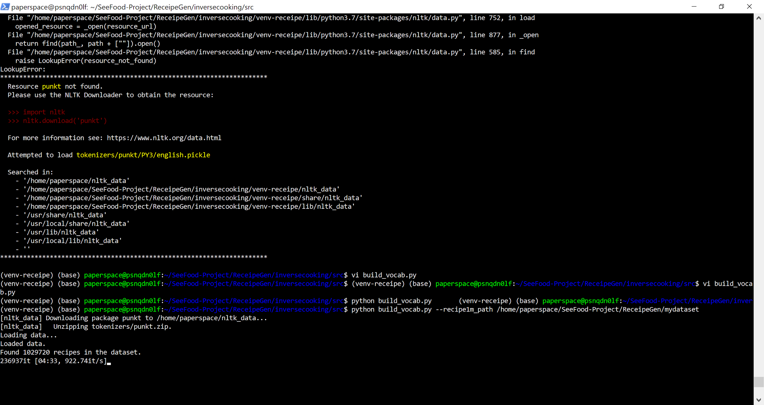
Stage 2

Slide 16
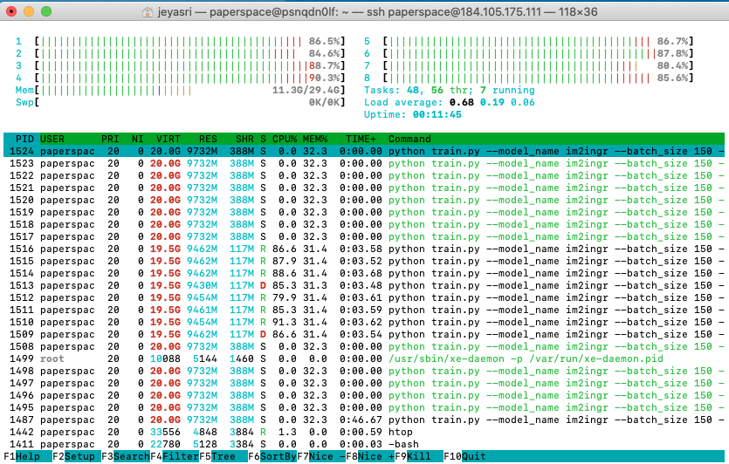
Training stage 3

Slide 17
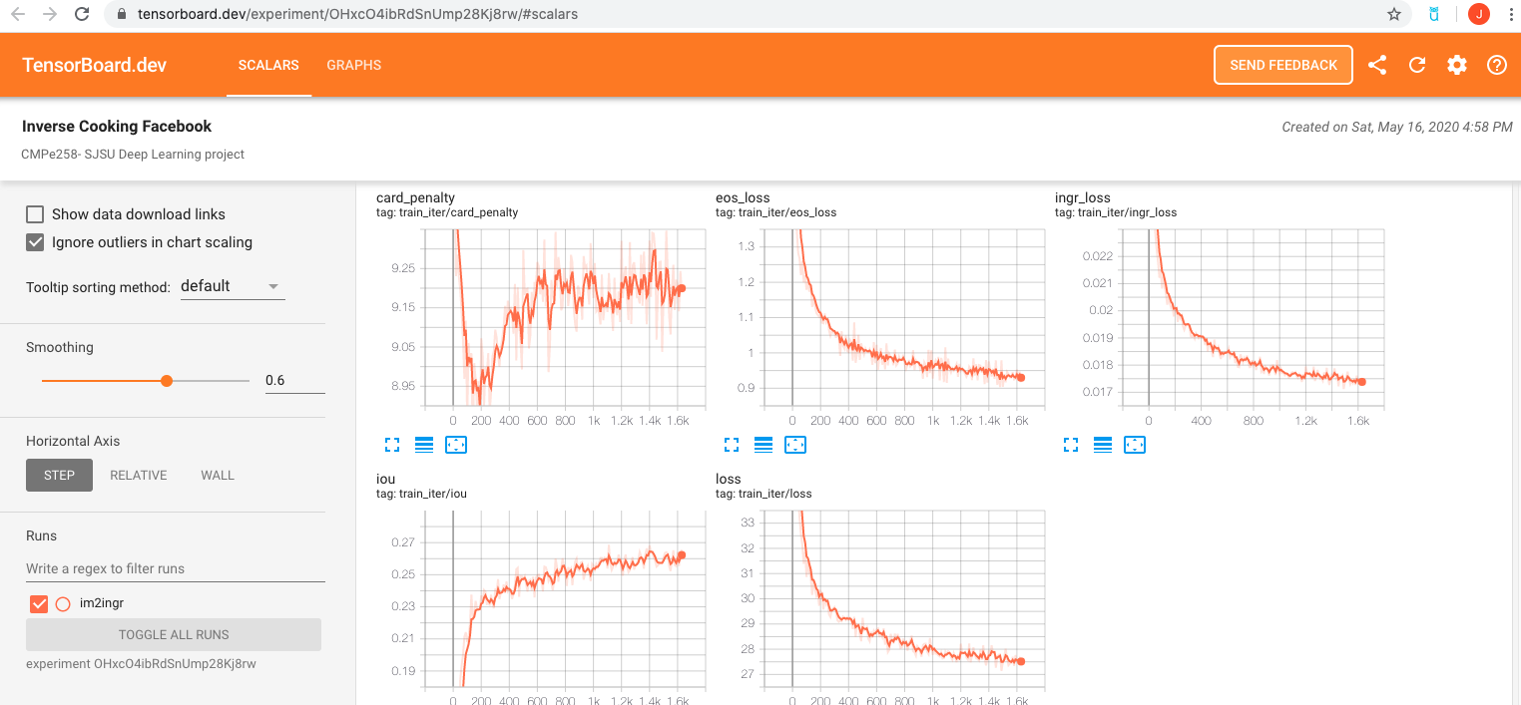
Tensorboard with loss metrics
Notes:
https://tensorboard.dev/experiment/OHxcO4ibRdSnUmp28Kj8rw/#scalars

Slide 18
Performance metrics
Stages | IoU | F Score
Ingredient Prediction | 32.11 | 48.61
Receipe Generation | 32.52 | 49.08
Training time:
Each Epoch takes 16 minutes
We have evaluated with 400 epoches

Slide 19
Calorie Estimation:
From the ingredients generated from Recipe module, we have computed the Calorie for the dish
Each recipe provided us the nutritional value for every 100 grams
Fat/ Saturation
Every gram of fat has 37 kilojoules
Protein
Every gram of protein has 17 kilojoules
Sodium
Every gram of sodium has 8 kilojoules
Sugar
Every gram of sugar has 17 kilojoules
Every kilojoule has 0.239006 calories
Using that information we used the following formula to estimate calories
0.24((fat * 37) + (protein*17) + (sodium *8) + (sugar * 17)) = total calories

Slide 20
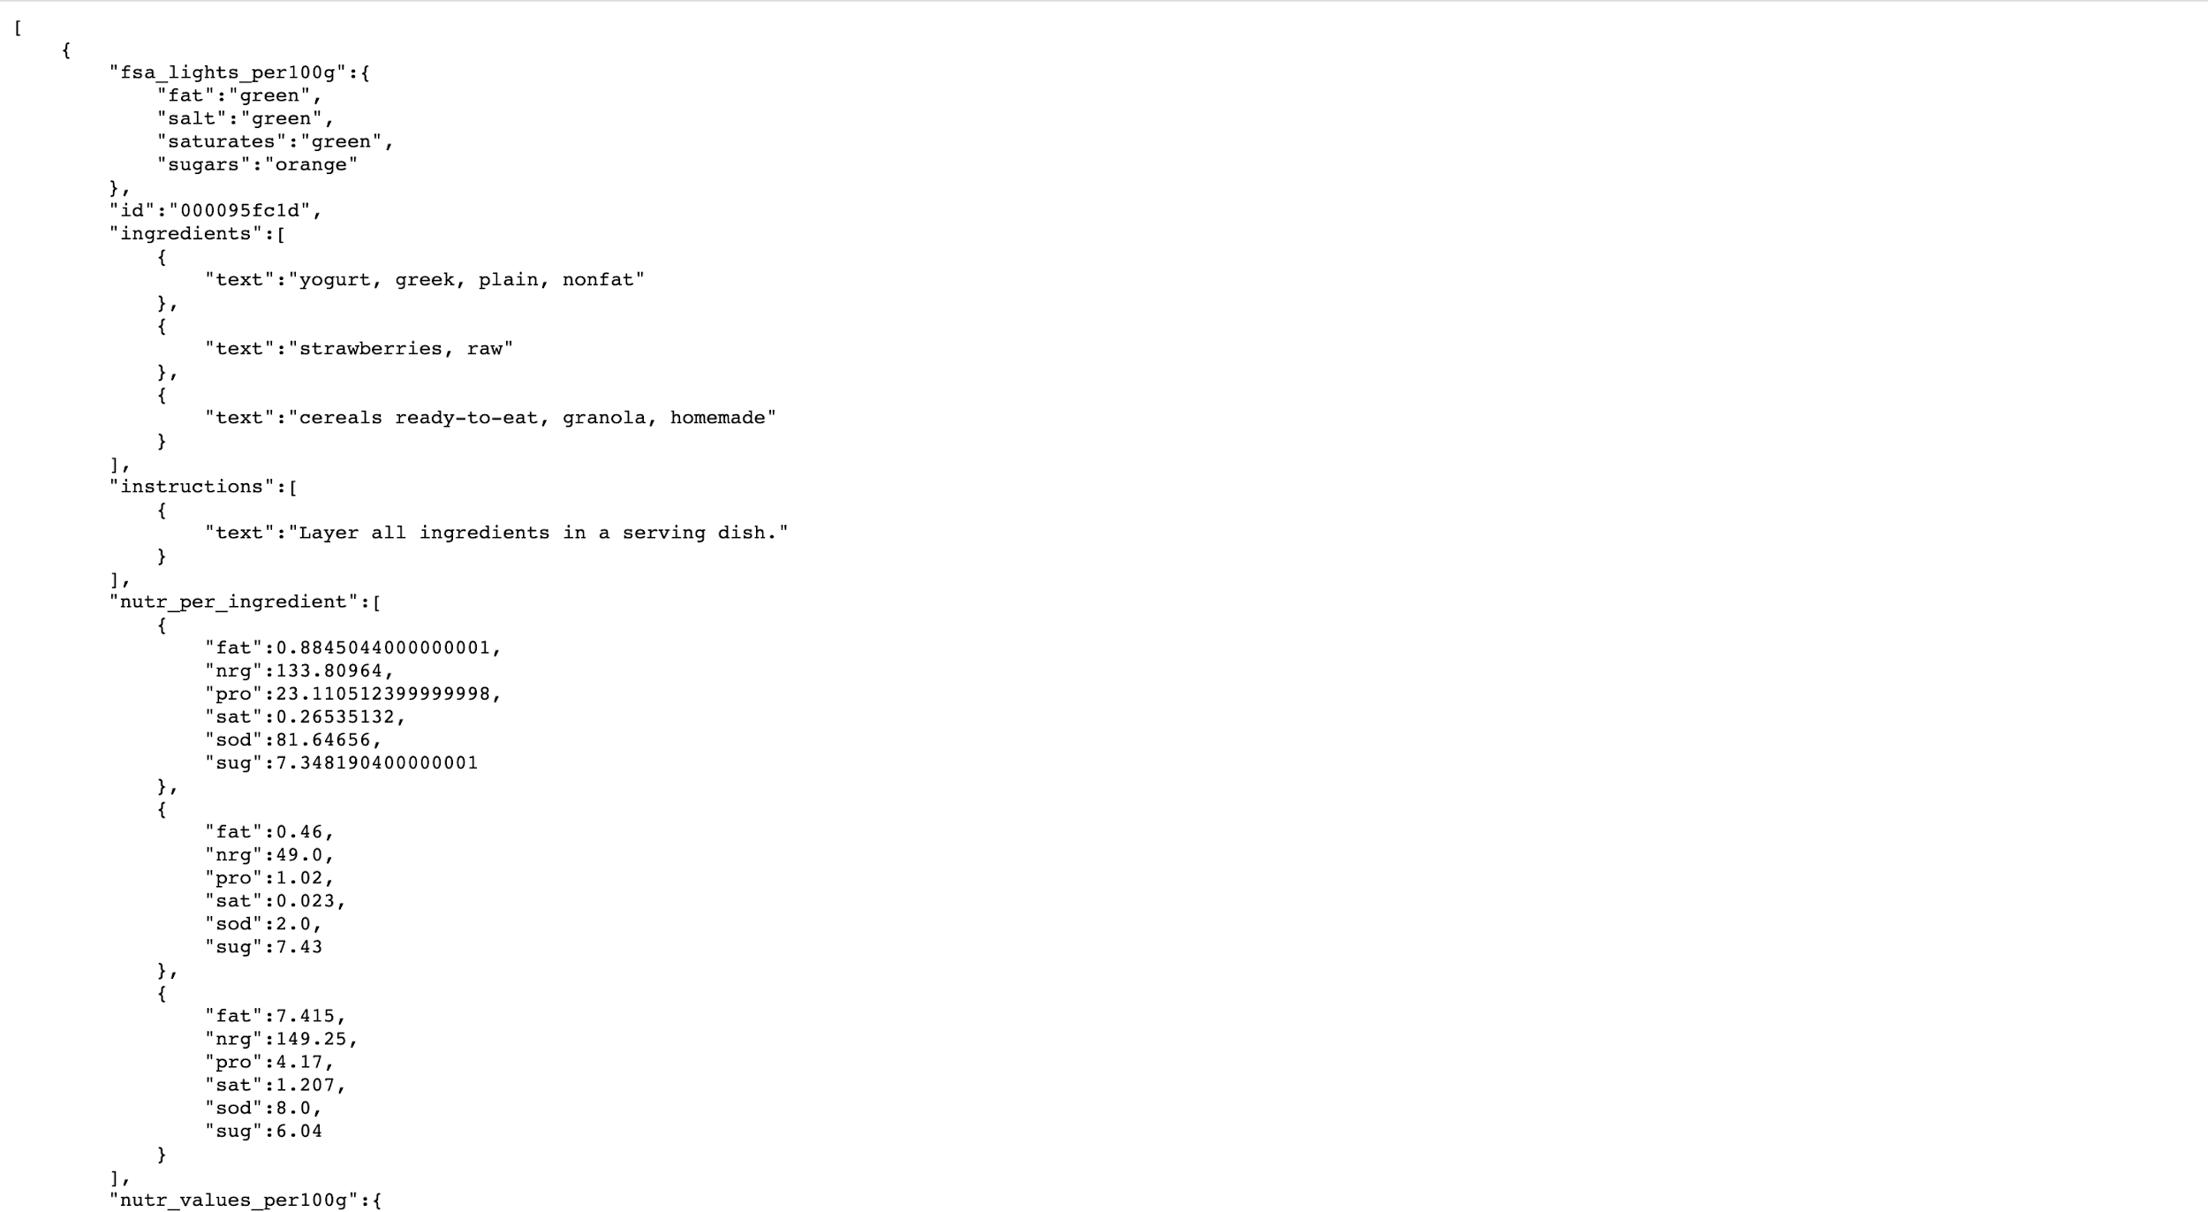

Slide 21
Technical challenges
Food Classification multi-class classification weights tuning
Receipe generation pipeline setup was difficult with tensorflow, pytorch and Cuda dependencies version
Calorie estimation is computed on Raw vegetables which we fixed for cooking ingredients
Merging the inference pipeline for three different modules

Slide 22
WebApp Demo
Read an image
Classify food category
Generate Recipe
Calculate Calorie

Slide 23
Thank you

